Slide 1
Building Classification models
Stephen F Elston | Principle Consultant , Quantia Analytics, LLC

Slide 2
Overview
Classification modelling process
Metrics for classification
Classification with Azure ML and R
Classification with Azure ML and Python

Slide 3
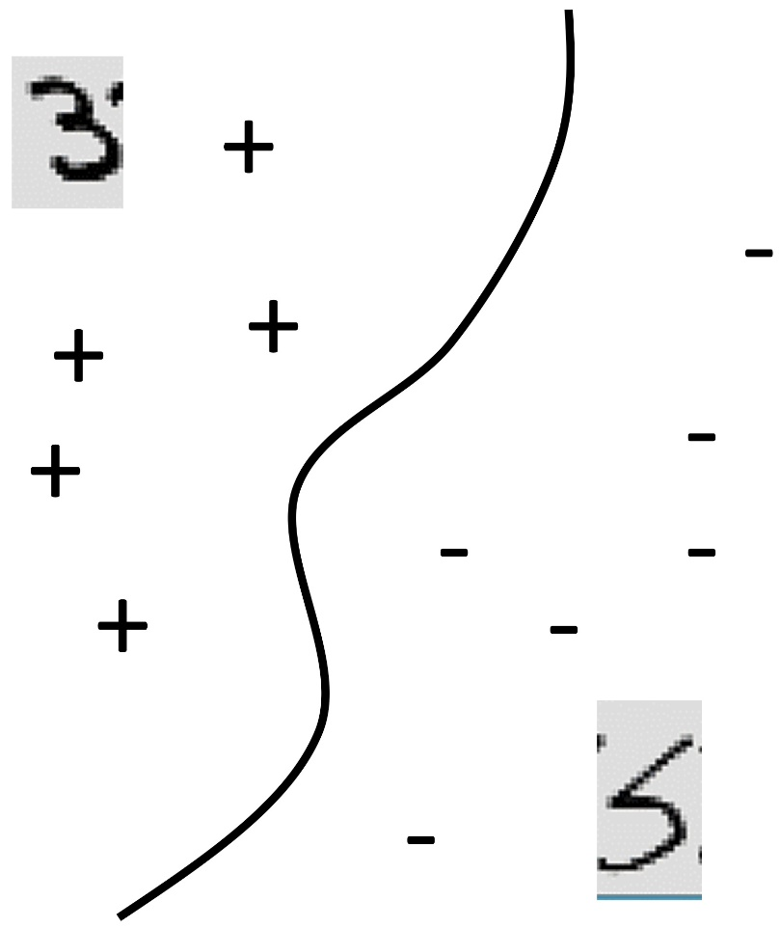
Classification
Formally, given training set (x_{i,}y_{i}) for i=1…n, we want to create a classification model f that can predict label y for a new x.
20
f(x)>0
f(x)=0
f(x)<0
f(x) = function(Events Last Year, Oldest Cable)
Events Last Year
0
1925
Oldest cable
2015
Notes:
That function is going to eat the two features … and produce a number. We take the sign of the number, and that’s the predicted class. Give me a new example I’ve never seen before, you give me it’s feature vector, I plug those values into f, then I get a number. If it’s a positive number I predict an explosion, if it’s a negative number I predict no explosion.

Slide 4
Classification process
Understand data relationships
Select features
Select metrics
Create model
Evaluate model
Improve model
Cross Validate model

Slide 5
Steps to improve models
Start by understanding errors
Filter or transform the data
Better feature engineering
Improve feature selection
Use a different type of model
Choice of model parameters

Slide 6
Decision Trees For Classification
Logical models
age≤30
age>30
#classes>8
#classes≤8
Bschool
No Bschool
laundry
No laundry
Male
Female
Predict y=-1
Predict y=-1
Predict y=-1
Predict y=1
Predict y=1
Predict y=1
Predict y=1
Predict y=-1

Slide 7
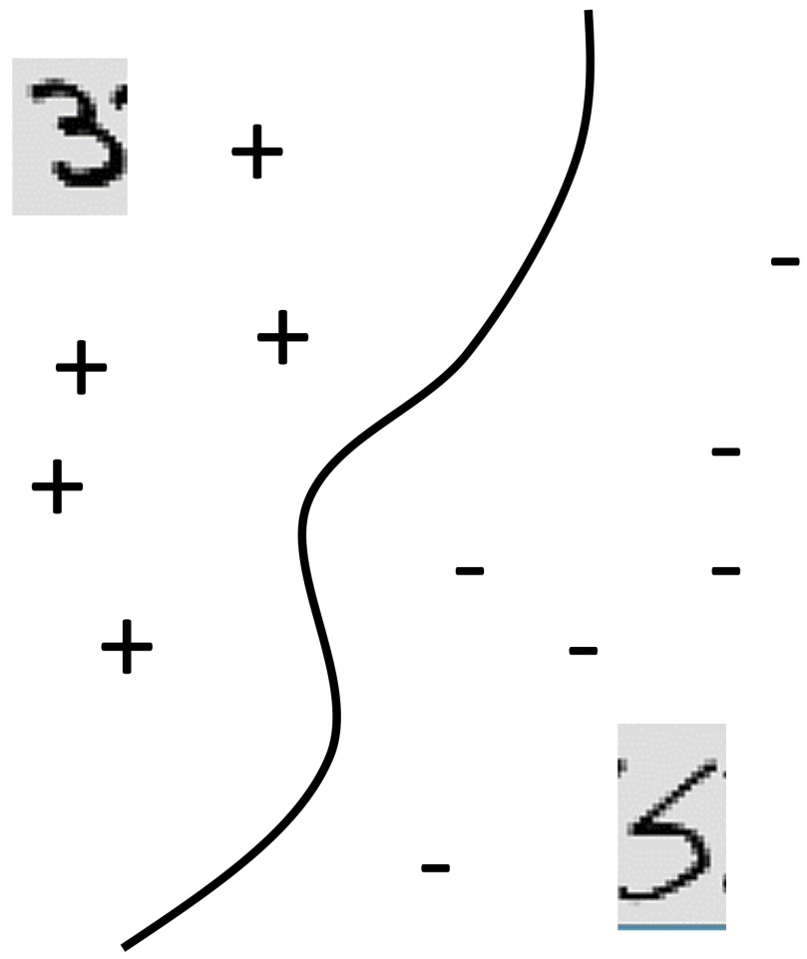
SVM
X(2,.)
0
x(1,.)

Slide 8
Metrics for Classification
Confusion matrix
 | Predicted Positive | Predicted Negative
Actual Positive | TP | FN
Actual Negative | FP | TN

Slide 9
Metrics for Classification
Accuracy = TP + TN / (TP + TN + FP + FN)
Precision or positive predictive value = TP/(TP + FP)
Recall = TP/(TP + FN)
F1 = Precision * Recall / (Precision + Recall)

Slide 10
ROC Curves
For a particular False Positive Rate (FPR), what is the True Positive Rate (TPR)?
1
TPR
AUC
0
FPR
0
1

Slide 11
Summary

Slide 12
Summary
Classification modelling process
Metrics for classification
Classification with Azure ML and R
Classification with Azure ML and Python

